Slide 1
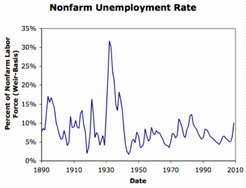

Lecture: 5.3.O.1 Macroeconomics for Beginners
The Polanyian Perplex:
Market validates property rights—that is what a market economy is: the ownership, production, and exchange of commodities.
“commodities” are properly pushed to their most valuable use by market forces, and it is right and proper that each use of them must pass a profitability test…
But people want stable employment—and the flow of finance to guarantee that
Why doesn’t the market guarantee stable employment as part of its normal functioning?
The “general glut”:
What people used to talk about, instead of recession and depressions
It focuses on what is going on: excess supply in pretty much all of the markets
3:00 of audio in this slide; 28:15 in this slide group
Notes:
This is an optional lecture.
If you took Econ 100b, and remember it, you can skip this. In fact, you are encouraged to do so.
In fact, if you took Econ 1, or AP economics in high school, and remember it, you are encouraged to and probably should skip this lecture…
Recall our Polanyian perplex: The only rights a market economy recognizes are property rights. But people want other rights recognized: they want the fabric of the communities they live in and the land they live on not to be the playthings of mysterious and to them irrational market processes; they want to receive the incomes that they deserve, and to be sure that others unworthy do not receive incomes they do not deserve; and they want the flow of finance to provide them with stable employment.
Now if you are a card-carrying neoliberal market fundamentalist, you can respond to complaints about the transformation of land and labor into "commodities" by saying: tough. If market forces are changing the community you live in in a way you do not like, it is because the change is providing utility to others. If market forces are not giving you the relative income you think you deserve, it is because the change is benefiting others. The market economy is productive creative destruction, and while the winners do not compensate the losers, the winners from market processor gain much more than the losers lose, and that is the definition of material progress.
You should not ask the market economy to be "fair" or “just”, said Friedrich von Hayek. What it is is productive.
Fairness and justice in distribution are, von Hayek maintained, unattainable, and attempts to attain them destroy productivity and liberty. Better, therefore, to settle for productivity and liberty.
And Hayek had a point.
But finance? Market instability in finance? The market economy does not generate a stable flow of finance that keeps things near full employment. It just does not do that. Just look at what happens to the unemployment rate. There is no possible justification for large-scale mass unemployment, is there?
But why doesn’t the market economy guarantee a flow of finance that supports stable employment levels as part of its normal functioning? Let us take a detour to answer that question.
Back at the start of economics, people did not speak of recessions and depressions. They spoke instead of a “general glut” of commodities: a situation in which pretty much everyone wants to sell, next to nobody wants to buy, and so there is enormous excess supply—a “glut”—of, everything—it is “general”—and while it goes on prices fall, businesses collapse into bankruptcy, and workers are fired and then find themselves with no prospect of finding replacement jobs.

Slide 2
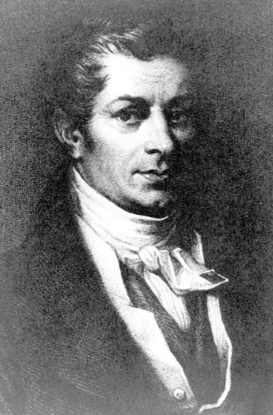
Back Up to 1803
Jean-Baptiste Say:
Argued back then that a “general glut” was a metaphysical impossibility
“If certain goods remain unsold, it is because other goods are not produced; and that it is production alone which opens markets to produce.... Whenever there is a glut, a superabundance, [an excess supply] of several sorts of merchandize, it is because other articles [in excess demand] are not produced in sufficient quantities…”
By 1830 Say had changed his mind. Speaking of 1825:
“The Bank [of England]... forced the return of its banknotes, and ceased to put new notes into circulation…. Commerce found itself deprived at a stroke of the advances on which it had counted, be it to create new businesses, or to give a lease of life to the old. As the bills that businessmen had discounted came to maturity, they were obliged to meet them….
“They sold goods for half what they had cost. Business assets could not be sold at any price. As every type of merchandise had sunk below its costs of production, a multitude of workers were without work. Many bankruptcies were declared among merchants and among bankers…”
1:45 of audio in this slide
Notes:
Let us back up to the start of economics, to 1803.
Back then people had little experience with the beast, and were genuinely worried about how a market economy would fit together. Since people were no longer largely self-sufficient, producing for their own use, what guarantee was there did any one individual would be able to sell what they had produced in their specialized occupation and use the cash they thereby earned to buy what they needed?
Back then, in 1803, Jean-Baptiste Say assured everybody that such a “general glut” was impossible.
There could be excess supply of one or a few commodities in the market, yes; but that meant that there was excess demand for other commodities; and this was a market signal that those currently making the commodity in excess supply should better themselves by changing their occupations to produce the commodities for which there was an excess demand:
>If certain goods remain unsold, it is because other goods are not produced; and that it is production alone which opens markets to produce.... Whenever there is a glut, a superabundance, [an excess supply] of several sorts of merchandize, it is because other articles [in excess demand] are not produced in sufficient quantities…
But by 1830 Say had change his mind. Then he narrated the British “general glut” of 1825 thus:
>“The Bank [of England]... forced the return of its banknotes, and ceased to put new notes into circulation…. Commerce found itself deprived at a stroke of the advances on which it had counted, be it to create new businesses, or to give a lease of life to the old. As the bills that businessmen had discounted came to maturity, they were obliged to meet them….
>They sold goods for half what they had cost. Business assets could not be sold at any price. As every type of merchandise had sunk below its costs of production, a multitude of workers were without work. Many bankruptcies were declared among merchants and among bankers…”

Slide 3
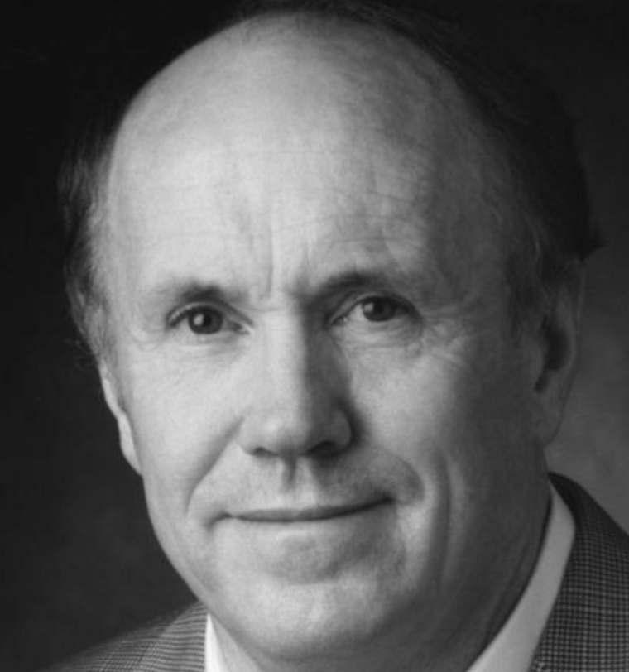

Garbage Economics
Unfortunately, some intellectual trash collection needed here…
A large number of economists—like Edward Prescott and Robert Lucas, both of whom were awarded the Nobel Prize (yes, it is strange)—argue that there are no “general gluts”: that when unemployment is high, it is invariably the case that:
The unemployed have decided that they don’t want to work right now—that a large chunk of the workers in the economy have decided to take a “Great Vacation’
There has been a loss of knowledge about how to produce, and so unemployed workers cannot add more value than the wages firms would have to pay to induce them to work—that there has been a “Great Forgetting”
That the rate of depreciation of the capital stock is now so high that it is not worth putting the machines in operation—that there is an ongoing “Great Rusting”
Cf. Narayana Kocherlakota, whose classification this is <http://web.archive.org/web/20090925174330/http://www.econ.umn.edu/%7Enkocher/stuff.pdf>
Now back in 2009, when Narayana wrote this, he went on immediately to say:
“None of these disturbances seem compelling, to put it mildly…. This… group of… scholars has worked… on the consequences of… disturbances… [not] on uncovering their true sources…”
Unfortunately, Lucas and Prescott and company believe that these are the true sources
& thus that nothing can (or perhaps should) be done to stabilize employment
For them, it is as though all large fluctuations in unemployment are like that of the spring of 2020, when non-socially-distanced jobs disappeared and unemployment rose as countries tried to suppress the coronavirus
3:30 of audio in this slide
Notes:
Unfortunately – I wish I did not—I have to do some intellectual garbage collection here. So feel free to skip the next four slides: they are super optional parts of this optional lecture. But I feel I have to include them in order to put a stake in the ground with respect to how I see these issues.
Whenever I have skipped over this, I have found questions appearing that forced me to backtrack and fill it in…
There are economist to argue that there is a justification for mass unemployment: that periodic such episodes are part of the health of the economic system.
And there are a large number of such economists.
Edward Prescott and Robert Lucas, for example. Both of whom were awarded the Nobel prize in economic sciences. They argue that there are, really, no general gluts. When unemployment is high, it is almost invariably the case that one or more of:
The unemployed are not really involuntarily unemployed. They say that they want jobs and cannot find them. But they are not really telling the truth. Instead, their desire to have a job right now has dropped, and so they have collectively decided to take a "Great Vacation”.
Businesses’ ability to operate their value chains has been disrupted by a temporary loss of knowledge about how to produce efficiently. There is, temporarily, no point to putting the unemployed to work because the unemployed workers cannot add more value then the wages firms would have to pay to induce them to work—there is, collectively, a "Great Forgetting" about how to produce efficiently.
The rate of depreciation of the capital stock is, again temporarily, so high that it is not worth putting the machines in operation—there is collectively, a “Great Rusting”.
Back in 2009, when he wrote up this classification of the fundamental shocks admitted in real business-cycle models, very sharp Narayana Kocherlakota immediately thereafter said that:
>”None of these disturbances seem compelling, to put it mildly…. This… group of… scholars has worked… on the consequences of… disturbances… [not] on uncovering their true sources…”
His belief was that Prescott, Lucas and company understood the implausibility of those origins of a "general glut", and that they did not take them seriously, but that they took these shortcuts because what they were really interested in was analyzing how the state of the economy evolved once it had gotten itself wedged into a condition of high unemployment.
But Narayana was wrong: it became very clear in 2008 that Prescott and Lucas took these ideas of a great vacation, a great forgetting, a great rusting in deadly earnest—and from them drew the conclusion that the government should step back, and just let the market economy do its high unemployment thing.
For them, it is as though all large fluctuations in unemployment are like that of the spring of 2020, with non-socially distanced jobs disappeared and unemployment rose worldwide as countries tried to suppress the coronavirus, and heroic steps to keep people working in those months would have been counterproductive from a societal welfare perspective.

Slide 4
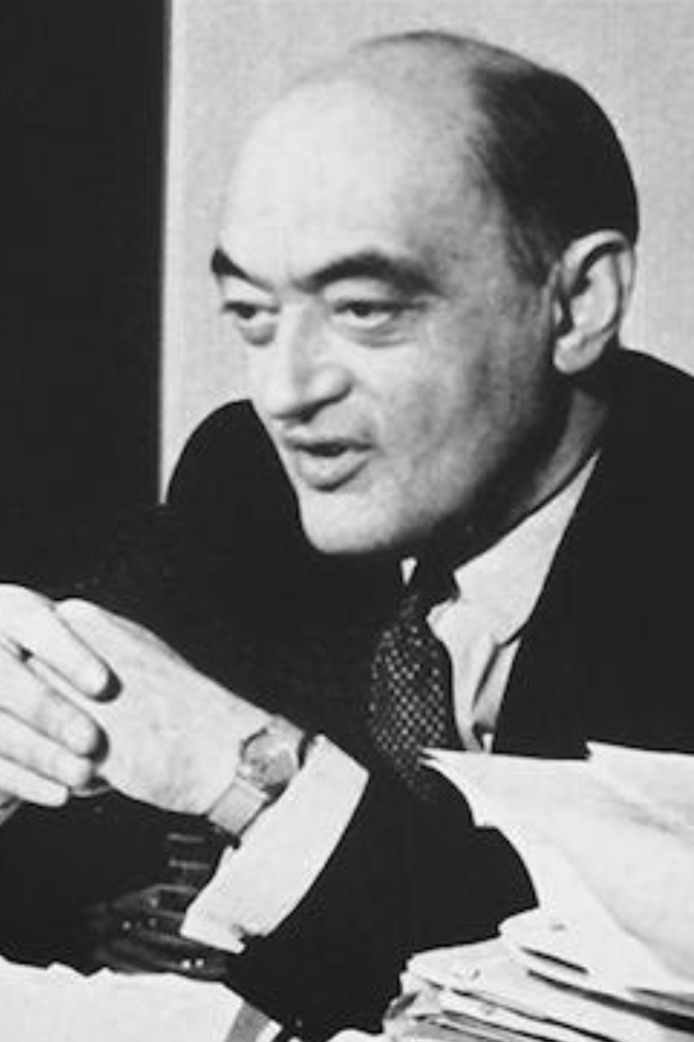
This Is a Long Tradition…
That nothing can, or perhaps should be done, to stabilize employment near full employment…
What is best, in the long run at least, is “austerity”…
& the unemployed should simply take the hit and wait for the market to cure itself…
“The market giveth, the market taketh away: blessed be the name of the market…”
For example, Joseph Schumpeter in the depths of the Great Depression of the 1930s:
“The chief difficulty… depressions are not simply evils, which we might attempt to suppress, but… adjustment to previous economic change. Most of what would be effective in remedying a depression would be equally effective in preventing this adjustment. This is especially true of inflation….
“In all cases… recovery is sound only if it does com of itself. For any revival which is merely due to artificial stimulus leaves part of the work of depressions undone and adds… new maladjustment of its own which has to be liquidated in turn….. Our story provides a presumption against remedial measures which work through money and credit…. Policies of this class are particularly apt to keep up, and add to, maladjustment, and to produce additional trouble in the future…"
2:00 of audio in this slide
Notes:
Indeed, this attachment to the idea that there is no such thing as a "general glut" that is a large-scale market failure—the idea that John Maynard Keynes called “Say's Law” even though Jean-Baptiste Say, who had believed it in 1803, and rejected it by 1830—has been remarkably persistent and remarkably popular.
It leads to the conclusion that nothing can, or perhaps even if something can nothing should, be done to stabilize employment near full employment. What is best, in the long run at least, is “austerity”: balancing government budgets, avoiding large increases in the money supply, and accepting that the unemployment should simply take the hit and wait for the market system to cure itself and re-balance itself back at full employment. "The market giveth, the market taketh away: blessed be the name of the market.”
For example, consider former Austrian finance minister and then Harvard professor Joseph Schumpeter writing in 1933, amid the depth of the Great Depression. He wrote:
>”The chief difficulty… Depressions are not simply evils, which we might attempt to suppress, but… adjustments to previous economic change. Most of what would be effective in remedying a depression would be equally effective in presenting this adjustment. This is especially true of inflation…
>”In all cases… recovery is sound only if it does come of itself. For any revival which is merely due to artificial stimulus leaves part of the work of depressions undone, and adds… new maladjustment of its own which has to be liquidated in turn….. Our story provides a presumption against remedial measures which work through money and credit…. Policies of this class are particularly apt to keep up, and add to, maladjustment, and to produce additional trouble in the future…"

Slide 5
My Advice:
Ignore all such “liquidationist” and “austerian” and “real-cycle” economists: they are profoundly unhelpful!!!!
0:30 of audio in this slide
Notes:
My advice: ignore all such “liquidationist" and “austerian” and “real-cycle” economists. They have not thought through the issues at even a basic level—a level that was perhaps state of the art for economics in 1829, but has not been state of the art since. They are not serious. Spending time debating them, or even trying to elucidate their thought, is profoundly unhelpful.

Slide 6
A Word from the Other Side of the Hill…
David Andolfatto, formerly of the FRBSL:
He writes <http://andolfatto.blogspot.com/2009/09/kocherlakota-on-state-of-macro.html>:
“This is exactly how I would expect a first-year undergraduate to interpret a model that they've seen for the first time. And DeLong claims that he has a PhD in economics. Let me help the poor lad along…”
“There is no need to appeal to DeLong's childish ‘great forgetting”' interpretation of a negative technology shock. A negative technology shock occurs when the realized return on investment is lower than expected… think of all the fibre optic cable planted across the world's oceans in anticipation of a demand that never materialized…. Recessions may be explained, in part, by collective mistakes on investments made in the past…
This is just not professionl: a fall in the value of new investment that is the result of excess investment made in the past because of mistaken expectations
4:30 of audio in this slide
Notes:
No I'm not sure now I am not sure whether it is fair or unfair to quote those who are… I guess "acolytes" is the right word… of Prescott and Lucas and company… For it really does seem to me to be more than a little bit of a cult…
David Andolfatto, formerly of the Federal Reserve Bank of St. Louis, back in 2010 when the stakes about whether the government should let the unemployment rate just sit at 10% or do something about it were… rather high, wrote:
>“[DeLong’s weblog post] is exactly how I would expect a first-year undergraduate to interpret a model that they've seen for the first time. And DeLong claims that he has a PhD in economics. Let me help the poor lad along…”
It is true: that is mean. But I was mean first.
In any event, Andolfatto goes on:
>“There is no need to appeal to DeLong's childish ‘great forgetting' interpretation of a negative technology shock. A negative technology shock occurs when the realized return on investment is lower than expected… think of all the fibre optic cable planted across the world's oceans in anticipation of a demand that never materialized…. Recessions may be explained, in part, by collective mistakes on investments made in the past…
This, in my view at least, is simply unprofessional.
Andolfatto has not thought the issues through.
A fall in the perceived value of producing investment goods is not a general negative “technology shock”. It does not lead to a fall in production of both investment and consumption goods. It is, rather, what Say was talking about back when in 1803 he wrote that excess supply of one commodity—in this case, investment goods—is excess demand for another: consumption goods. Andolfatto’s story would see a sectoral shift of labor and production out of the investment good sector and into the consumption goods sector, with whatever unemployment created short run and ‘frictional’ as workers head for sectors in which employers are eager to hire.
But that is not what we see. In a demand-driven business cycle, we see a fall in production and employment in both investment goods and consumption goods sectors, in a depression—in a general glut. Conversely, we see a sharp rise in production and employment in both investment goods and consumption good sectors in a boom—when there is overexuberance and confidence about the value of investment.
No it is true this was cutting edge macroeconomics once: back in the 1820s. But by 1829 both John Stuart Mill and Jean-Baptiste say had gotten straight the difference between a sectoral shifts shock that does not produce high unemployment, and an aggregate demand shock—the collapse in trust and confidence, and excess demand for cash, high unemployment, and a general glut.
Why cannot David Andolfatto—or Robert Lucas, or Edward Prescott—in 2010 think the issues through, and get to what was settled consensus economic doctrine 180 years before? Why did Joseph Schumpeter in 1933 forget what had been well-known 100 years before?
It is a mystery. And, in my view at least, failing to know the history of your own discipline is grossly unprofessional. And letting such failures to lead you to deny reality—to think, implicitly, even if you are not conscious that that is what your model is telling you, that as spending on investment goods fell in 2008-9 spending on consumption goods rose, when it did not—is idiotic. To say that something is metaphysically impossible—spending on both consumption and investment goods as well to fall at the same time—when it is in front of your face is just weird.
Enough: Now let me get out of this super-optional degression, and get back to the optional lecture.

Slide 7
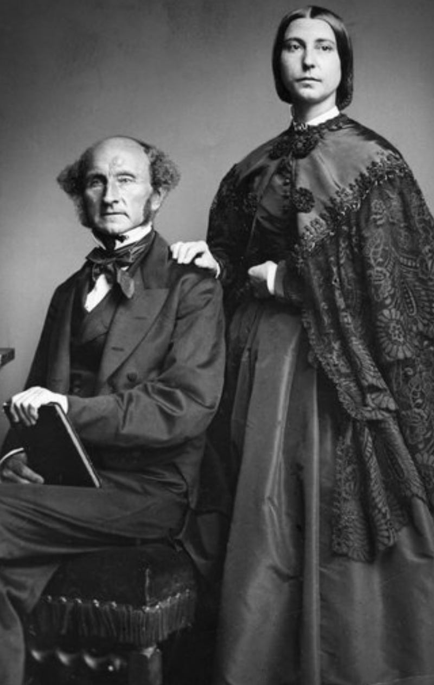
Curing a General Glut
John Stuart Mill in 1829
“Those who have... affirmed… [the possibility of] an excess [supply] of all commodities, never pretended that money was one…. Persons in general, at that particular time… liked better to possess money than any other commodity. Money, consequently, was in request, and all other commodities were in comparative disrepute.... There would seem… no particular impropriety in saying that there is a superabundance of all or most commodities, when all or most of them are in this same predicament…
A general glut, a general excess supply of other goods and commodities is an excess demand for cash money—for possession of stable immediate purchasing power
Money is liquid trust, and when general trust in counterparties has been eroded, people want more in the way of tangible, liquid trust
How then to cure a “general glut”?
A fall in prices and values so that the amount of money in the system matches demand
But this produces lots of bankruptcies, which further erode trust
Have an organization that can create money—the central bank—do so in large enough quantities
Have the government put people to work directly by paying them or buying stuff they market
2:00 of audio in this slide
Notes:
I said that John Stuart Mill—here looking as if he is doing an over-the-top cosplay of how people dressed and did their hair in the Victorian Era—had gotten the issues clear in 1829. Here is what he said:
>“Those who have... affirmed… [the possibility of] an excess [supply] of all commodities, never pretended that money was one…. Persons in general, at that particular time… liked better to possess money than any other commodity. Money, consequently, was in request, and all other commodities were in comparative disrepute....
>”There would seem… no particular impropriety in saying that there is a superabundance of all or most commodities, when all or most of them are in this same predicament…”
A general glut, a general excess supply of other goods and commodities is an excess demand for cash money—for possession of stable immediate purchasing power
Money is liquid trust, and when general trust in counterparties has been eroded, people want more in the way of tangible, liquid trust.
How then to cure a “general glut”? There are three possibilities:
A general fall in prices and values so that the amount of money in the system matches demand. But this produces lots of bankruptcies, which further erode trust. And there is nothing that makes your workers trust you less and slack off more than cutting their wages. This takes a long time, and is very painful indeed.
Have an organization that can create money—the central bank—do so in large enough quantities.
Have the government put people to work directly by paying them to do stuff or by buying stuff they sell in the market.
Those are the possibilities. All of them can work. The second and third are low-pain. The first is very high-pain. Guess what we did after 2009? Yep, the high-pain one. Why? I still do not understand why people took the actions they undertook.

Slide 8


Yoga Lessons and Lattes
A two-good economy: yoga lessons & lattes:
(This is what economists do: stripped-down thought experiments that we hope capture the essence, and then generalize)
Excess demand for yoga lessons is deficient demand for lattes
Yoga teachers are overworked
Latte-pullers stand idle
Latte-pullers retrain to teach yoga
System rebalances at a higher level of human satisfaction
Not a process we want to interfere with…
2:00 of audio in this slide
Notes:
Let us go back and clearly distinguish between a sectoral shift that is part of a process that enhances societal well-being—even though there is frictional unemployment along the way—and a general glut in which an excess demand for money induces an excess supply of pretty much all goods and services and of labor too which causes sustained excessive and completely pointless unemployment.
Since this is Berkeley, let us imagine a two good economy: the only things people produce and consume are yoga lessons and lattes. (This "let us imagine…" followed by a description of a ridiculous and oversimplified situation is the standard way that economists reason. The hope is that the ridiculous and oversimplified model captures the essential features of the complex real economy, and so allows us to reason through the essence of what is going on.)
Suppose that the good plain people of Berkeley decide that they are excessively wired and lack inner peace, so they collectively decide to cut down on their consumption of lattes, and boost their consumption of yoga lessons. What happens next in our oversimplified economy? Well, there is excess demand for yoga teachers: they are overworked and overstressed. And there is excess supply of lattes: baristas stand around idle, or find the cafés are unwilling to pay them for as many or perhaps for any shifts—unemployment.
But it is clear to everyone that the excess supply of lattes is the mirror image of the excess demand for yoga lessons. So baristas have an incentive to retrain as yoga instructors. They are unemployed while they do. But when they get their certification they move on over and now teach yoga, and the economy is back to full employment with a higher level of utility since what is produced now matches consumer demand.
This frictional unemployment and sectoral shift process is not something we want to interfere with—indeed, we want to accelerate it, to the extent that providing information and smoothing people’s way to structural adjustment can be accomplished.

Slide 9
Yoga Lessons, Lattes, and Cash
Deficient demand for yoga lessons and lattes is excess demand for cash:
Yoga teachers stand idle
Latte-pullers stand idle
Can’t retrain to produce cash
In normal times bankers can produce cash
But what if times are not normal?
The central bank can produce cash—it is still a trusted counterparty…
The government can buy stuff—it is still a trusted counterparty…
1:45 of audio in this slide
Notes:
Now suppose that, instead, the collapse in demand for lattes is not the result of a heightened demand for yoga lessons but of a heightened demand for cash. There is a breakdown of social trust, and people feel that they ought to have more cash in their pockets to be prudent. What happens next?
Some baristas are unemployed. And as they become unemployed their incomes drop. And with lower incomes, they can afford to take fewer yoga lessons. So demand for yoga lessons drops. So now some yoga teachers are unemployed too.
What is to be done? There is excess demand for cash. But baristas and yoga teachers cannot shift into the cash-making business, not unless they set up a printing press in their basement and start counterfeiting.
And there—unless and until something happens to diminish people’s demand for or boost the supply of cash—the economy sticks.
If times were normal, banks could step in: “We can give you a low-interest loan, and deposit the proceeds in this new checking account we will also give you! It is as good as cash!” But that requires general trust in the financial system, for investors to be willing to commit their funds to boost the banks’ capital to serve as reserves to fractionally-back their deposits. And, indeed, a general glut does not happen without a loss of trust in the mechanisms by which the financial system usually expands credit in response to demand.
But if nobody trusts the banks enough to commit the capital so that they can expand their loans and deposits? Then the only source of cash is the central bank—it sits at the center of the financial system and remains a trusted counterparty. And if people trust the government’s checks not to bounce, it too can buy stuff and so put people to work and cure the general glut.

Slide 10
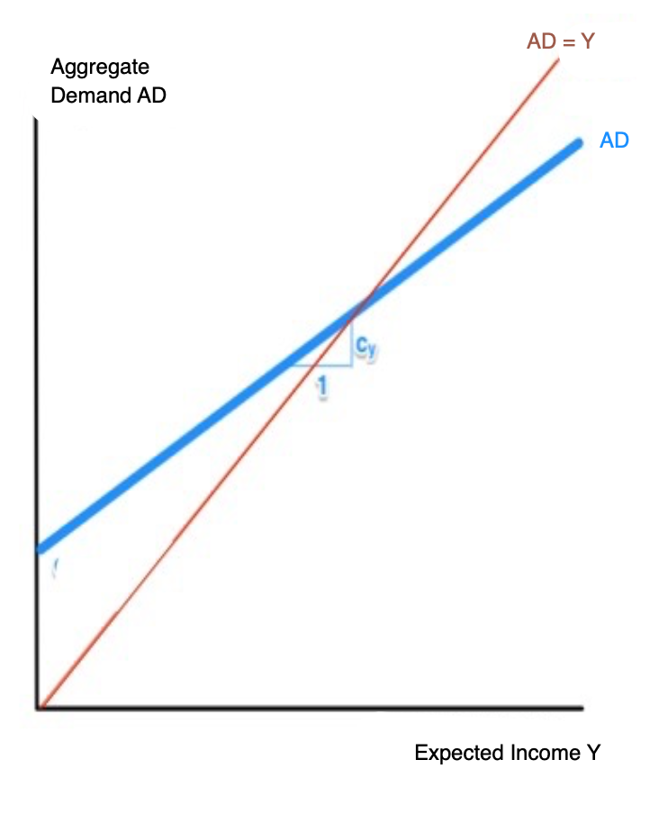
When Does the Government Have to Step in?
The simplest Keynesian macro model:
Divide the relevant population into three:
Consumers buying consumption goods and services C
Businesses expanding their capacity through investment spending I
Foreigners buying our exports EX
Private expenditure: C+I+(GX-IM)
Government purchases G and taxes T
Central bank sets real interest rate r
Wants to set aggregate demand AD equal to potential output Y*:
C+I+(GX-IM)+G = AD = Y*
Lower T raises C consumption spending
(Higher AD also raises C by amount c )
Lower r raises I investment spending
(Lower r also reduces the value of the currency and so raises EX)
Higher G raises AD directly
y
2:15 of audio in this slide
Notes:
When does the government have to step in? When is it the case that there is an excess demand for cash—that aggregate demand for all commodities is less than the society’s expected income?
The simplest Keynesian macro model divides the relevant population into three, plus the central bank, and the government.
There are consumers who buy consumption of goods and services. Call that spending flow C. The relevant part of that is spending on domestic goods, total spending C minus imports IM, C-IM. C-IM depends on the level of aggregate demand AD, since the spending of the community is also households’ incomes; and on the taxes T that the government levies and takes out of the flow of income, plus consumer confidence, and other things.
There are businesses that expand their capacity through investment spending I. A lower real interest rate r boosts investment spending, as does that mysterious thing called "business confidence or "animal spirits”.
Foreigners buy gross exports GX.
Then there is also the purchases by the government: G. C + I + (GX-IM) + G = AD, aggregate demand, and the economy is in balance and there is full employment when those add up to the economy’s level of potential output Y*.
You have seen this before.
Graph total aggregate demand AD as a function of what people expect their income to be Y on a graph. Where expectations are validated is where the economy sits. And the task of the government is to make the supply of cash high enough, and thus real interest rates low enough, and to have government purchases large enough, that the curves cross at AD = Y = Y*: then there is no excess demand (or supply) of cash at full employment.

Slide 11
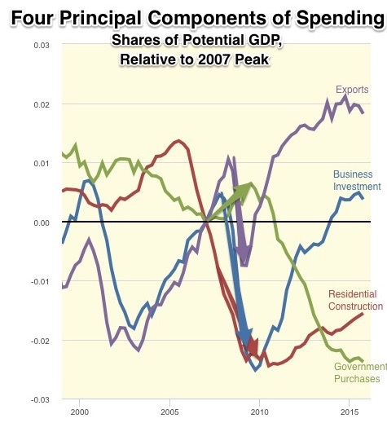
An Example of a General Glut
2008-2009:
Collapse of trust due to subprime derivatives leverage debacle
Enormous jump up in demand for “cash”
The components of investment spending I collapse:
Business investment (blue)
Residential investment (red)
Plus exports (purple)
Federal Reserve does not add enough cash to the system (because of its operating procedures)
Obama stimulus (green arrow) grossly inadequate to keep the spending flow high enough for full employment
Compare to 2005-2008:
Collapse of residential investment with collapse of housing bubble
But no depression, no “general glut”\
In absence of excess demand for cash, business investment and exports take up the slack
y
5:00 of audio in this slide
Notes:
Note that even a large structural shift in the economy will not necessarily produce a general glut—or its reverse.
If people decide to switch spending from one commodity to another without attempting to get more cash into their pockets, you will indeed have a structural shift—but not massive unemployment.
Consider the United States between 2005 and 2007. As the housing bubble then unwound, spending on housing and new housing construction both dropped massively. Why? Because foreigners who had earned dollars by selling their exports to the U.S. decided that investing in housing and building new houses was no longer attractive, and so they took their money and used it to buy U.S. exports and to fund business investment as well.
Housing investment spending sat down. Business investment spending and spending on U.S. exports stood up. And the U.S. economy remained at full employment—with a structural shift.
But then at the start of 2008 came a collapse of trust due to subprime derivatives leverage debacle. Fear of bankruptcies led to an enormous jump up in the demand for “cash”. The components of investment spending I collapsed:
business investment (blue), and residential investment (red), plus those who would have bought U.S. exports decided to hoard cash instead (purple).
The Federal Reserve did not add enough cash to the system because of its operating procedures: it bought short-term Treasury bonds in exchange for providing banks with reserve deposits at its branches. Usually, you see, reserve deposits enable banks to make more loans and accept more checking account deposits, and so boost the effective money supply. The problem was that, by the end of 2008, as the panic spread and interest rates on Treasury bonds went to zero, they had already become part of the effective money supply—and it had not been enough. So the Federal Reserve’s open-market operations were then the equivalent of trying to bail a canoe by dipping your bucket into the water at the front but then emptying the bucket into the back of the canoe.
No, I do not understand why the Federal Reserve did not figure this out at the time.
And government purchases? There was the Obama stimulus—the green arrow. It was grossly inadequate to do the job of offsetting the falls in investment spending and exports and so keeping the spending flow high enough for full employment.
This concludes my—optional—macroeconomics for beginners lecture. You should have already known this. But I hope, if you had forgotten, it reminded you. And I hope that, if you remembered, it gave you a deeper understanding by providing a different slant and approach to conclusions and facts you already knew.

